Slide 1

Aircrack-ng: A Comprehensive Overview
In today's interconnected world, wireless networks are ubiquitous. However, the convenience of wireless connectivity comes with inherent security risks. Aircrack-ng is a powerful suite of tools designed to assess the security of wireless networks.

Slide 2
What is Aircrack-ng?
Auditing Wireless Networks
Key Functionalities
Aircrack-ng is an open-source suite of tools for auditing wireless networks. It encompasses a collection of programs that can be used to monitor wireless networks, capture packets, crack WEP and WPA/WPA2-PSK keys, and perform various attacks.
Monitor wireless networks
Capture packets
Crack WEP and WPA/WPA2-PSK keys
Perform various attacks

Slide 3
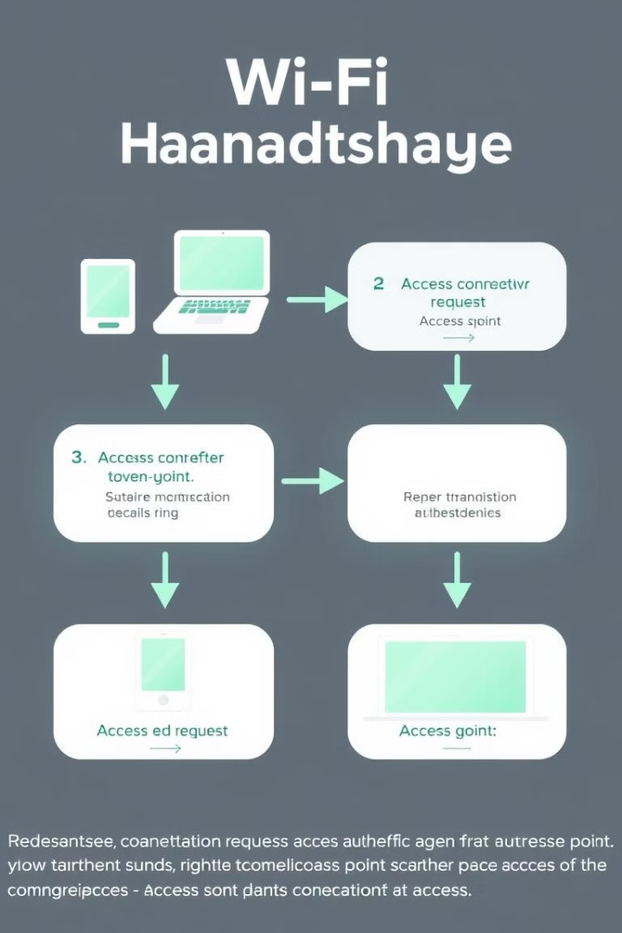
Core Concepts
1
Wireless Protocols
2
Encryption Basics
Understand the fundamentals of 802.11 Wi-Fi standards (a, b, g, n, ac, ax), focusing on encryption mechanisms: WEP, WPA, WPA2, and WPA3.
Familiarize yourself with basic cryptographic concepts like keys, algorithms, and hashing.

Slide 4


Aircrack-ng Tools in Detail
airodump-ng
aireplay-ng
Captures packets transmitted over the wireless network. Displays information about nearby access points (APs): BSSID (MAC address), channel, ESSID (network name), encryption type, signal strength. Monitors client devices associated with the AP.
Injects packets into the wireless network. Enables various attacks: deauthentication attacks, fake AP creation, beacon flooding.
aircrack-ng
Analyzes captured packets to crack WEP and WPA/WPA2-PSK keys. Implements various cracking techniques: FMS, PTW, KoreK for WEP, and dictionary attacks, brute-force attacks, and rainbow tables for WPA/WPA2-PSK.

Slide 5
How Aircrack-ng Works
WEP Cracking
Packet Capture: Aircrack-ng captures data packets transmitted over a WEP-encrypted network. IV Analysis: It analyzes the Initialization Vectors (IVs) used in WEP encryption. Key Recovery: By capturing enough packets with repeated IVs, Aircrack-ng can use algorithms like FMS and KoreK to recover the WEP key.
1
2
WPA/WPA2-PSK Cracking
Packet Capture: Aircrack-ng captures handshake packets exchanged between a wireless client and the access point during the authentication process. Dictionary Attacks: It attempts to crack the WPA/WPA2-PSK password by trying various combinations of characters from a dictionary file. Brute-Force Attacks: In more complex scenarios, Aircrack-ng can perform brute-force attacks to try all possible password combinations, although this can be time-consuming.

Slide 6

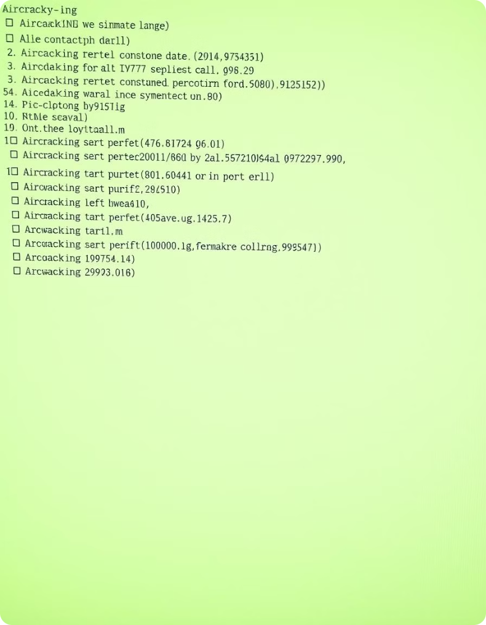




Advanced Concepts
Monitor Mode
Packet Injection
Understanding how to put your wireless network card into monitor mode to capture packets.
Learning how to inject packets into the wireless network, which requires specific hardware and driver support.
Kali Linux
Wireless Security Best Practices
Exploring the Kali Linux operating system, a popular platform for penetration testing and security auditing, which includes Aircrack-ng and other security tools.
Discussing best practices for securing wireless networks, such as using strong, unique passwords, enabling WPA2/WPA3 encryption, disabling WPS, keeping firmware updated, and using MAC address filtering.

Slide 7




Ethical Considerations and Legal Implications
Ethical Hacking
Emphasize the importance of ethical hacking and obtaining proper authorization before conducting any security assessments.
Legal Ramifications
Discuss the legal and ethical ramifications of unauthorized network attacks.
Responsible Use
Highlight the importance of using Aircrack-ng responsibly for educational purposes, penetration testing with consent, and personal network security assessments.

Slide 8

Conclusion
Aircrack-ng is a valuable tool for understanding the security vulnerabilities of wireless networks. By understanding how Aircrack-ng works, network administrators can take steps to improve the security of their wireless networks and protect sensitive data. However, it is essential to use Aircrack-ng responsibly and ethically.

Slide 9
Team Members
Farida Mohamed
222101175
Ali Aboughadeer
222101010
Marwan Hany
221101634
4
Rawan Hesham
221100803

Slide 10
Thank You!

